Slide 1
Historical Context of Focus Schools
Evan Kramer | Data Governance and Accountability
Notes:
Evan

Slide 2
Agenda
Objectives
Accountability Overview
What Are Focus Schools?
Currently
Historically
By the Numbers
Wrap Up

Slide 3
Objectives
We will be able to:
Describe how the department currently identifies Focus schools
Describe how the department previously identified Focus schools
Summarize the geographic distribution of Focus schools

Slide 4
One Big Caveat
Our ATSI methodology is currently out of compliance.
We amended our CSI methodology to exclude 2017-18 data after last-minute legislation.
When USED reviewed our amendment, they said our CSI methodology did not comply.

Slide 5
Accountability Overview

Slide 6
School scores reflect multiple indicators and minimum performance expectations.
Determine “F” Schools: Minimum Performance Goal
Success Rates
Schools in bottom 5%
Safe Harbor
Schools with Level 4 or 5 TVAAS
Multiple Indicators for determining other scores
Determine “A-D” Scored Schools
All Students Grade
on each indicator
Student Groups Grade
for each group on each indicator
Achievement
AMO or Absolute
Growth
TVAAS
Readiness
Ready Graduates
Chronically Out of School
ELPA
ACCESS for ELs
Priority/Comprehen-sive Support
Overall Grade
for All Students and Subgroups
Overall School Grade = A – D
Overall School Grade = F
Graduation Rate
Notes:
How should we change this from A-F to 0-4?

Slide 7
School scores reflect multiple indicators and minimum performance expectations.
Determine “F” Schools: Minimum Performance Goal
Success Rates
Schools in bottom 5%
Safe Harbor
Schools with Level 4 or 5 TVAAS
Multiple Indicators for determining other scores
Determine “A-D” Scored Schools
All Students Grade
on each indicator
Student Groups Grade
for each group on each indicator
Achievement
AMO or Absolute
Growth
TVAAS
Readiness
Ready Graduates
Chronically Out of School
ELPA
ACCESS for ELs
Priority/Comprehen-sive Support
Overall Grade
for All Students and Subgroups
Overall School Grade = A – D
Overall School Grade = F
Graduation Rate
Notes:
How should we change this from A-F to 0-4?

Slide 8
School scores reflect multiple indicators and minimum performance expectations.
Determine “F” Schools: Minimum Performance Goal
Success Rates
Schools in bottom 5%
Safe Harbor
Schools with Level 4 or 5 TVAAS
Multiple Indicators for determining other scores
Determine “A-D” Scored Schools
All Students Grade
on each indicator
Student Groups Grade
for each group on each indicator
Achievement
AMO or Absolute
Growth
TVAAS
Readiness
Ready Graduates
Chronically Out of School
ELPA
ACCESS for ELs
Priority/Comprehen-sive Support
Overall Grade
for All Students and Subgroups
Overall School Grade = A – D
Overall School Grade = F
Graduation Rate
Notes:
How should we change this from A-F to 0-4?

Slide 9
School scores reflect multiple indicators and minimum performance expectations.
Determine “F” Schools: Minimum Performance Goal
Success Rates
Schools in bottom 5%
Safe Harbor
Schools with Level 4 or 5 TVAAS
Multiple Indicators for determining other scores
Determine “A-D” Scored Schools
All Students Grade
on each indicator
Student Groups Grade
for each group on each indicator
Achievement
AMO or Absolute
Growth
TVAAS
Readiness
Ready Graduates
Chronically Out of School
ELPA
ACCESS for ELs
Priority/Comprehen-sive Support
Overall Grade
for All Students and Subgroups
Overall School Grade = A – D
Overall School Grade = F
Graduation Rate
Notes:
How should we change this from A-F to 0-4?

Slide 10
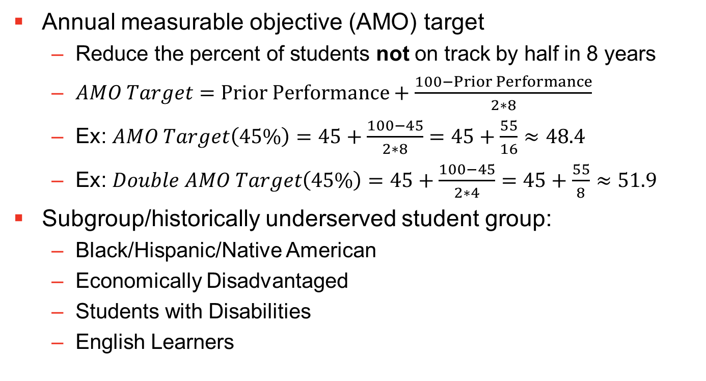
Terminology and Definitions
Annual measurable objective (AMO) target
Reduce the percent of students not on track by half in 8 years
$AMO Target=Prior Performance+\frac{100−Prior Performance}{2∗8}$
Ex: $AMO Target\left(45\%\right)=45+\frac{100−45}{2∗8}=45+\frac{55}{16}≈48.4$
Ex: $Double AMO Target\left(45\%\right)=45+\frac{100−45}{2∗4}=45+\frac{55}{8}≈51.9$
Subgroup/historically underserved student group:
Black/Hispanic/Native American
Economically Disadvantaged
Students with Disabilities
English Learners

Slide 11
Summary: Methodology
Multiple indicators
Achievement
Growth
Readiness
Graduation rate
Chronic absenteeism
English language proficiency
Priority schools
Bottom 5% without consistent, strong growth
Subgroups
BHN
ED
EL
SWD

Slide 12
What Are Focus Schools?

Slide 13
Currently

Slide 14
Focus schools consist of both targeted support and additional targeted support schools.
Focus schools
Targeted Support (TSI) schools
Additional Targeted Support (ATSI) schools

Slide 15
Focus schools are underperforming for one or more student groups.
TSI
ESSA:
“…any subgroup of students is consistently underperforming…”
State plan:
Overall accountability score of 1.0 or less
Bottom 5 percent for any subgroup
Includes racial/ethnic groups
ATSI
ESSA:
“…any subgroup of students, on its own, would lead to identification [as a CSI school]…”
State plan:
Overall accountability score of 1.0 or less and any accountability subgroup in bottom 5 percent
Two or more subgroups in bottom 5 percent, including racial/ethnic groups

Slide 16
Focus schools are identified yearly and can exit each year.
Exit
Not on the next list
Can become Priority schools
Identified for the same subgroup for three consecutive years and does not meet AMO targets
Will identify first full list this summer

Slide 17
Historically

Slide 18
Focus schools were first identified in 2012.
Three pathways:
3-year graduation rates less than 60 percent
3-year success rates below 10 percent for any subgroup (including all students and racial/ethnic groups)
3-year gaps among the largest in the state
BHN vs. all
ED vs. non-ED
EL vs. non-EL
SWD vs. non-SWD
Safe harbors
Better than state averages
Gap reduction

Slide 19
Focus schools used to be identified every three years, but they could exit yearly.
First identified 2012
Exit criteria
Graduation rate above 75 percent
Success rate above 20 percent
Reduction in gap size
Focus schools always constituted 10 percent of each pool
No Priority consequence for not exiting

Slide 20
By the Numbers

Slide 21
Focus schools were first identified in 2012.
372 distinct schools have ever been Focus schools.
Across 113 districts
Most schools were only identified once, but about 40 percent of identified schools were Focus for more than one year.
Currently there are 102 ATSI schools in 40 districts.
Notes:
20
3
Bedford County
2
40
1
Bledsoe County
3
50
1
Blount County
4
70
2
Campbell County
5
100
1
Carter County
6
110
1
Cheatham County
7
120
1
Chester County
8
140
1
Clay County
9
180
1
Cumberland County
10
190
23
Davidson County
11
220
1
Dickson County
12
260
1
Franklin County
13
280
1
Giles County
14
301
1
Greeneville
15
330
7
Hamilton County
16
350
1
Hardeman County
17
380
2
Haywood County
18
400
1
Henry County
19
460
2
Johnson County
20
470
5
Knox County
21
490
1
Lauderdale County
22
500
1
Lawrence County
23
540
1
McMinn County
24
550
1
McNairy County
25
570
4
Madison County
26
630
3
Montgomery County
27
640
1
Moore County
28
700
1
Polk County
29
710
5
Putnam County
30
740
2
Robertson County
31
750
1
Rutherford County
32
760
1
Scott County
33
792
14
Shelby County
34
800
2
Smith County
35
820
1
Sullivan County
36
821
1
Bristol
37
830
1
Sumner County
38
860
1
Unicoi County
39
870
2
Union County
40
900
1
Washington County
Showing 18 to 40 of 40 entries

Slide 22
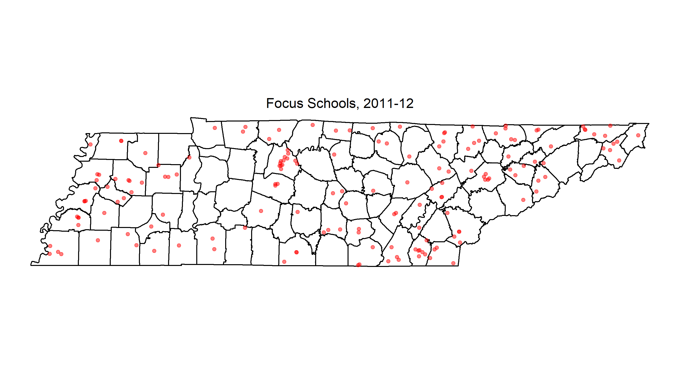
We first identified 167 Focus schools in 2012.
Notes:
20
3
Bedford County
2
40
1
Bledsoe County
3
50
1
Blount County
4
70
2
Campbell County
5
100
1
Carter County
6
110
1
Cheatham County
7
120
1
Chester County
8
140
1
Clay County
9
180
1
Cumberland County
10
190
23
Davidson County
11
220
1
Dickson County
12
260
1
Franklin County
13
280
1
Giles County
14
301
1
Greeneville
15
330
7
Hamilton County
16
350
1
Hardeman County
17
380
2
Haywood County
18
400
1
Henry County
19
460
2
Johnson County
20
470
5
Knox County
21
490
1
Lauderdale County
22
500
1
Lawrence County
23
540
1
McMinn County
24
550
1
McNairy County
25
570
4
Madison County
26
630
3
Montgomery County
27
640
1
Moore County
28
700
1
Polk County
29
710
5
Putnam County
30
740
2
Robertson County
31
750
1
Rutherford County
32
760
1
Scott County
33
792
14
Shelby County
34
800
2
Smith County
35
820
1
Sullivan County
36
821
1
Bristol
37
830
1
Sumner County
38
860
1
Unicoi County
39
870
2
Union County
40
900
1
Washington County
Showing 18 to 40 of 40 entries

Slide 23
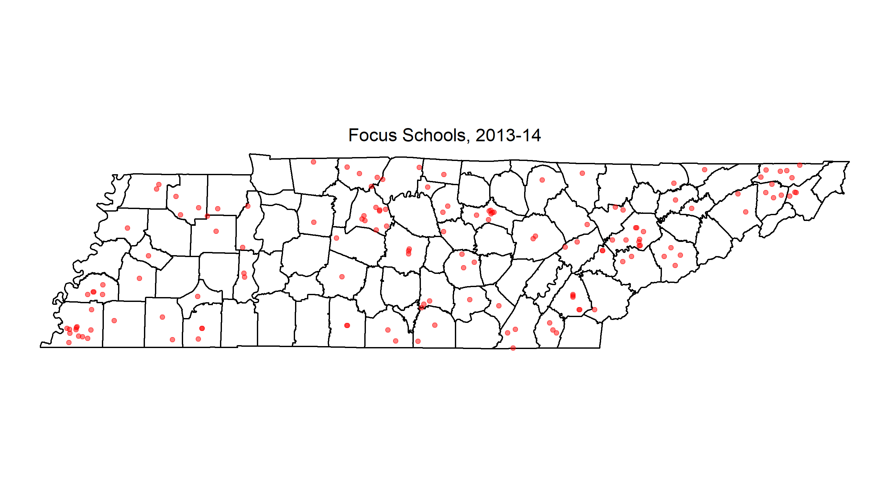
We identified 148 Focus schools in 2014.
Notes:
20
3
Bedford County
2
40
1
Bledsoe County
3
50
1
Blount County
4
70
2
Campbell County
5
100
1
Carter County
6
110
1
Cheatham County
7
120
1
Chester County
8
140
1
Clay County
9
180
1
Cumberland County
10
190
23
Davidson County
11
220
1
Dickson County
12
260
1
Franklin County
13
280
1
Giles County
14
301
1
Greeneville
15
330
7
Hamilton County
16
350
1
Hardeman County
17
380
2
Haywood County
18
400
1
Henry County
19
460
2
Johnson County
20
470
5
Knox County
21
490
1
Lauderdale County
22
500
1
Lawrence County
23
540
1
McMinn County
24
550
1
McNairy County
25
570
4
Madison County
26
630
3
Montgomery County
27
640
1
Moore County
28
700
1
Polk County
29
710
5
Putnam County
30
740
2
Robertson County
31
750
1
Rutherford County
32
760
1
Scott County
33
792
14
Shelby County
34
800
2
Smith County
35
820
1
Sullivan County
36
821
1
Bristol
37
830
1
Sumner County
38
860
1
Unicoi County
39
870
2
Union County
40
900
1
Washington County
Showing 18 to 40 of 40 entries

Slide 24
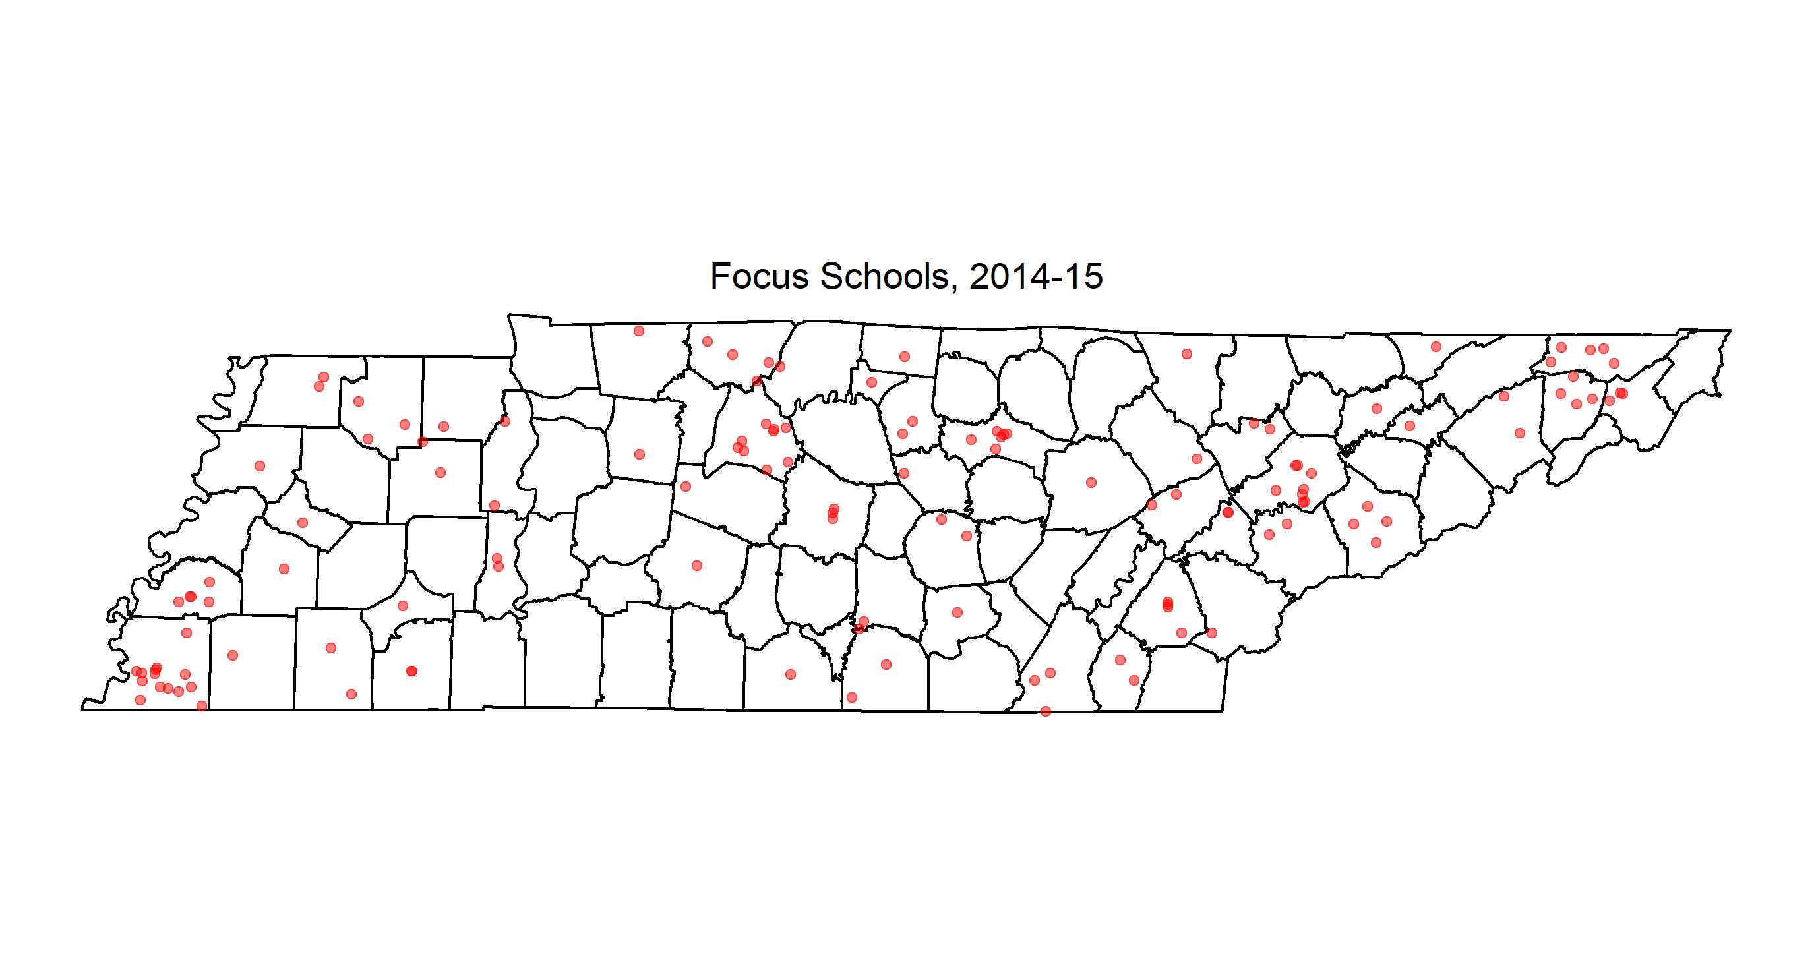
18 of these schools exited in 2015.
Notes:
20
3
Bedford County
2
40
1
Bledsoe County
3
50
1
Blount County
4
70
2
Campbell County
5
100
1
Carter County
6
110
1
Cheatham County
7
120
1
Chester County
8
140
1
Clay County
9
180
1
Cumberland County
10
190
23
Davidson County
11
220
1
Dickson County
12
260
1
Franklin County
13
280
1
Giles County
14
301
1
Greeneville
15
330
7
Hamilton County
16
350
1
Hardeman County
17
380
2
Haywood County
18
400
1
Henry County
19
460
2
Johnson County
20
470
5
Knox County
21
490
1
Lauderdale County
22
500
1
Lawrence County
23
540
1
McMinn County
24
550
1
McNairy County
25
570
4
Madison County
26
630
3
Montgomery County
27
640
1
Moore County
28
700
1
Polk County
29
710
5
Putnam County
30
740
2
Robertson County
31
750
1
Rutherford County
32
760
1
Scott County
33
792
14
Shelby County
34
800
2
Smith County
35
820
1
Sullivan County
36
821
1
Bristol
37
830
1
Sumner County
38
860
1
Unicoi County
39
870
2
Union County
40
900
1
Washington County
Showing 18 to 40 of 40 entries

Slide 25

16 more exited in 2017, for a total of 114 Focus schools.
Notes:
20
3
Bedford County
2
40
1
Bledsoe County
3
50
1
Blount County
4
70
2
Campbell County
5
100
1
Carter County
6
110
1
Cheatham County
7
120
1
Chester County
8
140
1
Clay County
9
180
1
Cumberland County
10
190
23
Davidson County
11
220
1
Dickson County
12
260
1
Franklin County
13
280
1
Giles County
14
301
1
Greeneville
15
330
7
Hamilton County
16
350
1
Hardeman County
17
380
2
Haywood County
18
400
1
Henry County
19
460
2
Johnson County
20
470
5
Knox County
21
490
1
Lauderdale County
22
500
1
Lawrence County
23
540
1
McMinn County
24
550
1
McNairy County
25
570
4
Madison County
26
630
3
Montgomery County
27
640
1
Moore County
28
700
1
Polk County
29
710
5
Putnam County
30
740
2
Robertson County
31
750
1
Rutherford County
32
760
1
Scott County
33
792
14
Shelby County
34
800
2
Smith County
35
820
1
Sullivan County
36
821
1
Bristol
37
830
1
Sumner County
38
860
1
Unicoi County
39
870
2
Union County
40
900
1
Washington County
Showing 18 to 40 of 40 entries

Slide 26
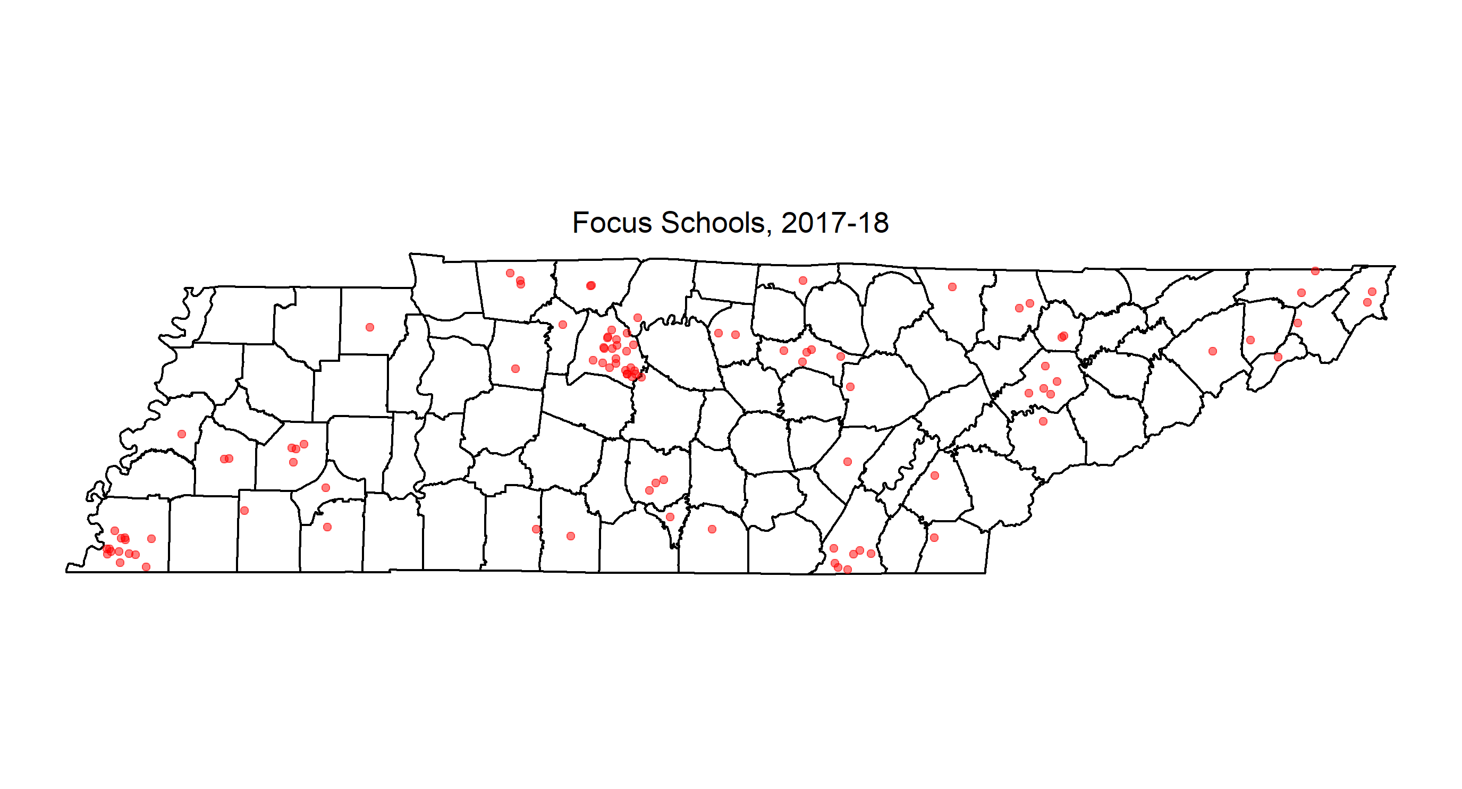
Our new methodology identifies slightly more Focus schools in urban areas.
Notes:
20
3
Bedford County
2
40
1
Bledsoe County
3
50
1
Blount County
4
70
2
Campbell County
5
100
1
Carter County
6
110
1
Cheatham County
7
120
1
Chester County
8
140
1
Clay County
9
180
1
Cumberland County
10
190
23
Davidson County
11
220
1
Dickson County
12
260
1
Franklin County
13
280
1
Giles County
14
301
1
Greeneville
15
330
7
Hamilton County
16
350
1
Hardeman County
17
380
2
Haywood County
18
400
1
Henry County
19
460
2
Johnson County
20
470
5
Knox County
21
490
1
Lauderdale County
22
500
1
Lawrence County
23
540
1
McMinn County
24
550
1
McNairy County
25
570
4
Madison County
26
630
3
Montgomery County
27
640
1
Moore County
28
700
1
Polk County
29
710
5
Putnam County
30
740
2
Robertson County
31
750
1
Rutherford County
32
760
1
Scott County
33
792
14
Shelby County
34
800
2
Smith County
35
820
1
Sullivan County
36
821
1
Bristol
37
830
1
Sumner County
38
860
1
Unicoi County
39
870
2
Union County
40
900
1
Washington County
Showing 18 to 40 of 40 entries

Slide 27
Wrap Up

Slide 28
Revisit Objectives
We should now be able to:
Describe how the department currently identifies Focus schools
Describe how the department previously identified Focus schools
Summarize the geographic distribution of Focus schools

Slide 30
Added Wrinkles

Slide 31
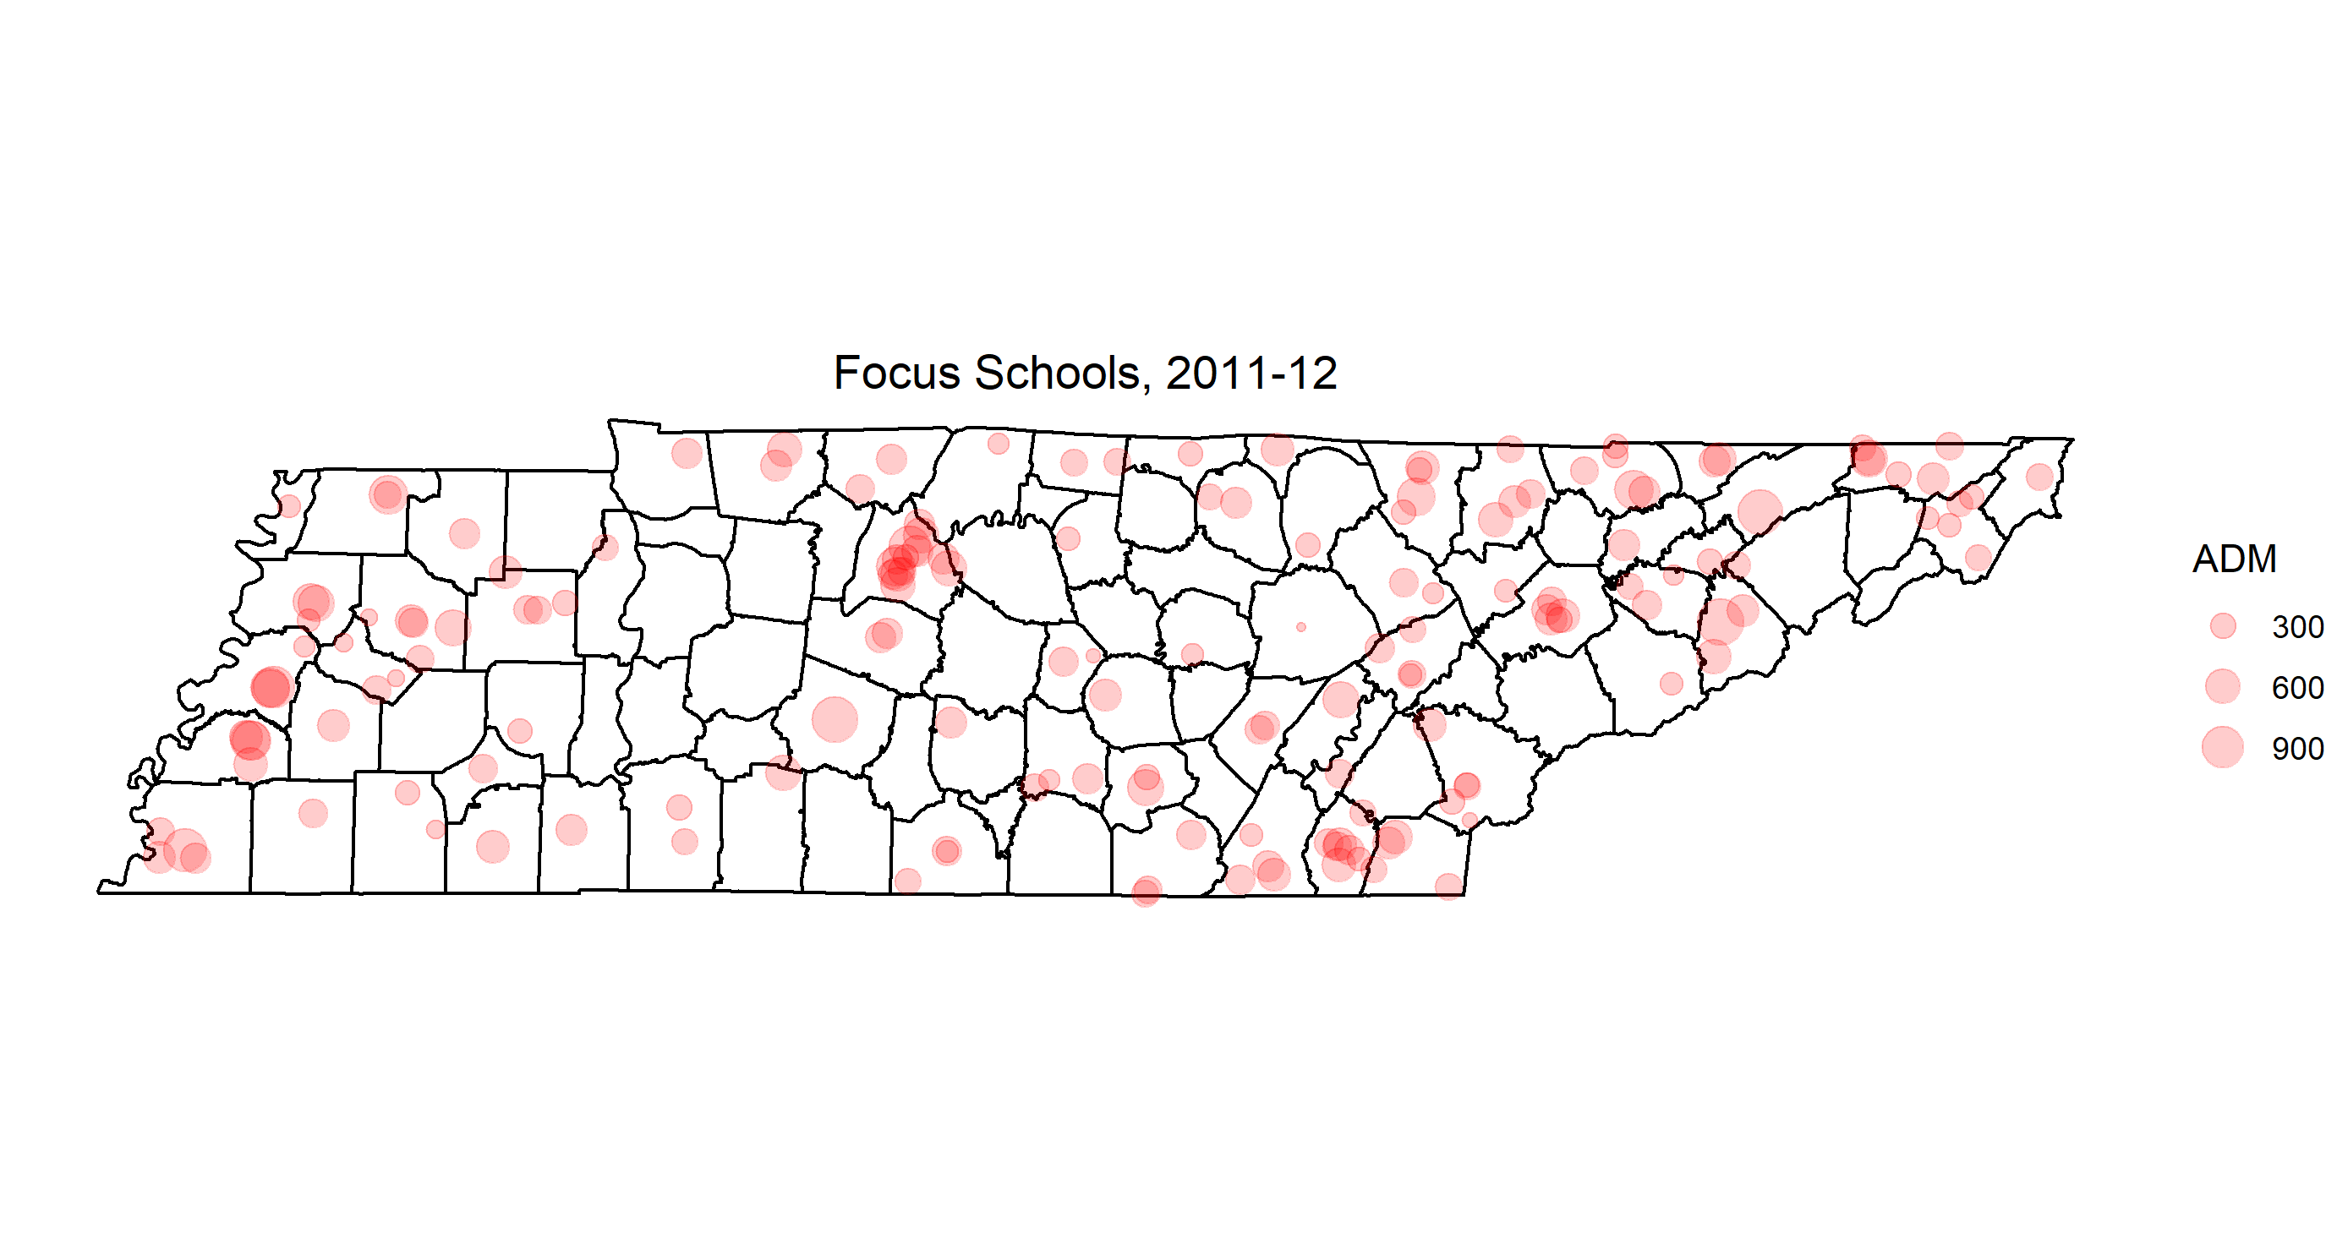
Notes:
20
3
Bedford County
2
40
1
Bledsoe County
3
50
1
Blount County
4
70
2
Campbell County
5
100
1
Carter County
6
110
1
Cheatham County
7
120
1
Chester County
8
140
1
Clay County
9
180
1
Cumberland County
10
190
23
Davidson County
11
220
1
Dickson County
12
260
1
Franklin County
13
280
1
Giles County
14
301
1
Greeneville
15
330
7
Hamilton County
16
350
1
Hardeman County
17
380
2
Haywood County
18
400
1
Henry County
19
460
2
Johnson County
20
470
5
Knox County
21
490
1
Lauderdale County
22
500
1
Lawrence County
23
540
1
McMinn County
24
550
1
McNairy County
25
570
4
Madison County
26
630
3
Montgomery County
27
640
1
Moore County
28
700
1
Polk County
29
710
5
Putnam County
30
740
2
Robertson County
31
750
1
Rutherford County
32
760
1
Scott County
33
792
14
Shelby County
34
800
2
Smith County
35
820
1
Sullivan County
36
821
1
Bristol
37
830
1
Sumner County
38
860
1
Unicoi County
39
870
2
Union County
40
900
1
Washington County
Showing 18 to 40 of 40 entries

Slide 32
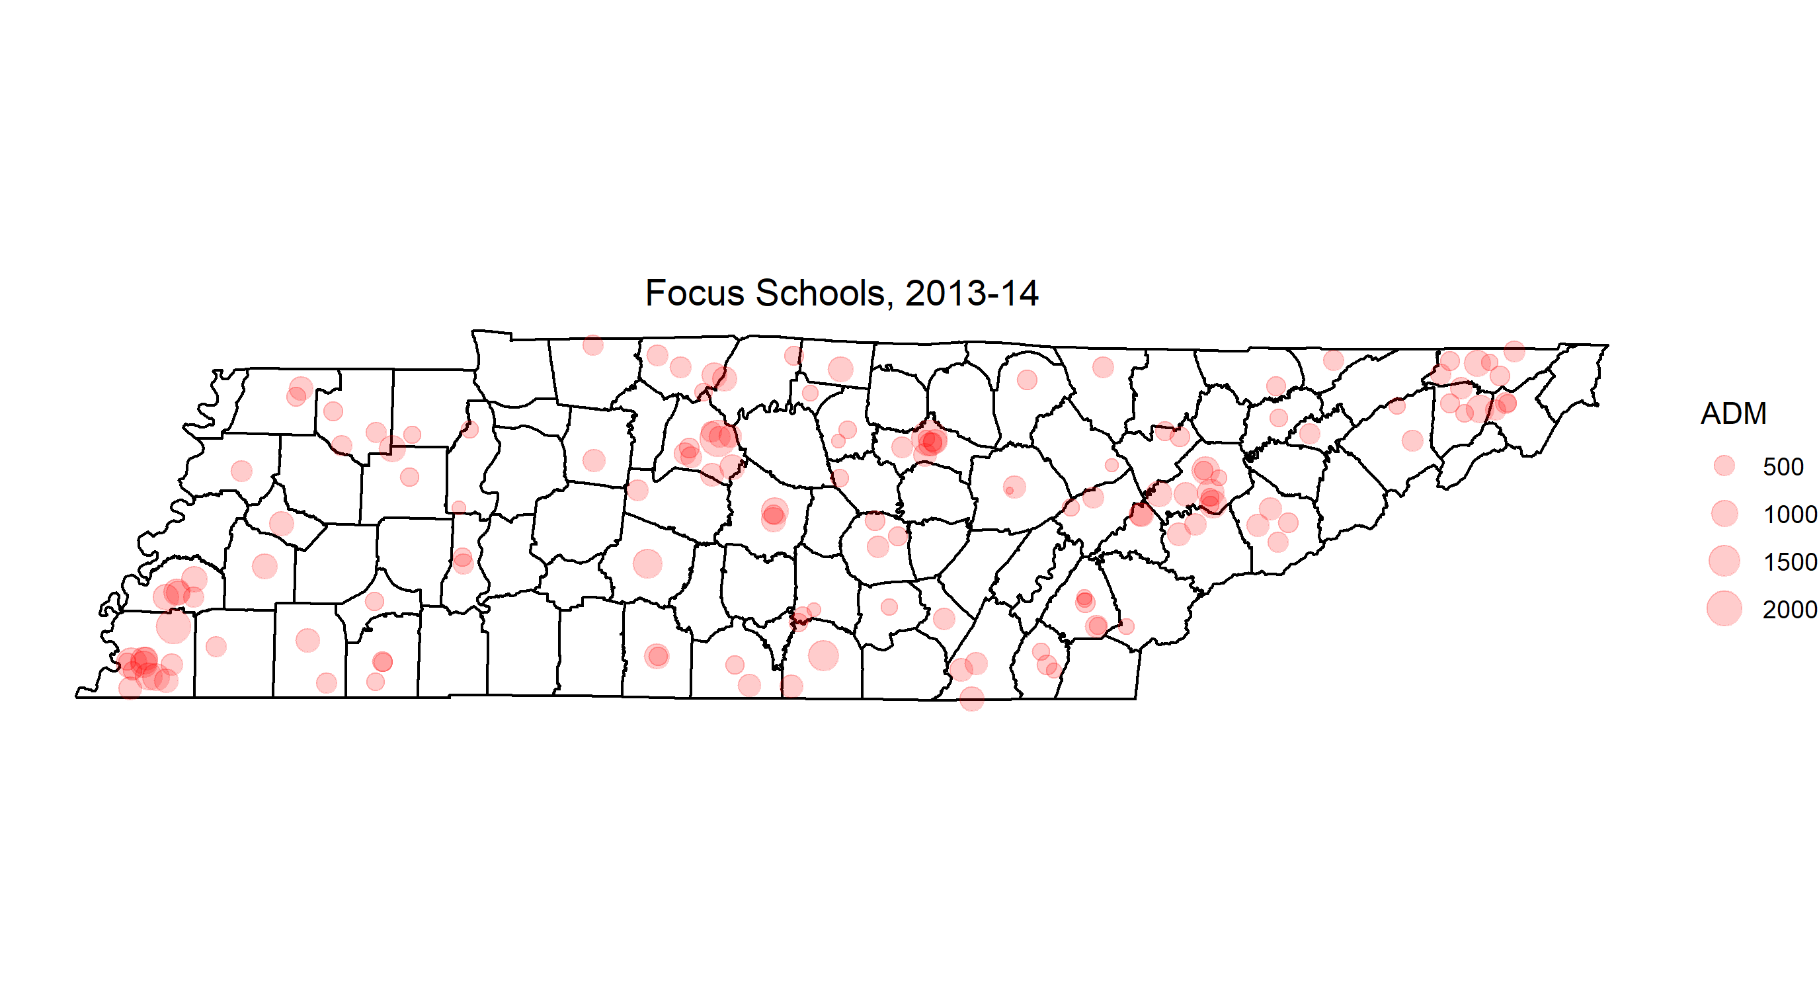
Notes:
20
3
Bedford County
2
40
1
Bledsoe County
3
50
1
Blount County
4
70
2
Campbell County
5
100
1
Carter County
6
110
1
Cheatham County
7
120
1
Chester County
8
140
1
Clay County
9
180
1
Cumberland County
10
190
23
Davidson County
11
220
1
Dickson County
12
260
1
Franklin County
13
280
1
Giles County
14
301
1
Greeneville
15
330
7
Hamilton County
16
350
1
Hardeman County
17
380
2
Haywood County
18
400
1
Henry County
19
460
2
Johnson County
20
470
5
Knox County
21
490
1
Lauderdale County
22
500
1
Lawrence County
23
540
1
McMinn County
24
550
1
McNairy County
25
570
4
Madison County
26
630
3
Montgomery County
27
640
1
Moore County
28
700
1
Polk County
29
710
5
Putnam County
30
740
2
Robertson County
31
750
1
Rutherford County
32
760
1
Scott County
33
792
14
Shelby County
34
800
2
Smith County
35
820
1
Sullivan County
36
821
1
Bristol
37
830
1
Sumner County
38
860
1
Unicoi County
39
870
2
Union County
40
900
1
Washington County
Showing 18 to 40 of 40 entries

Slide 33
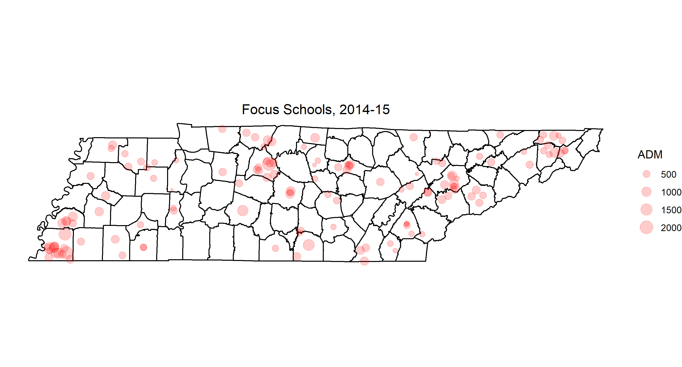
Notes:
20
3
Bedford County
2
40
1
Bledsoe County
3
50
1
Blount County
4
70
2
Campbell County
5
100
1
Carter County
6
110
1
Cheatham County
7
120
1
Chester County
8
140
1
Clay County
9
180
1
Cumberland County
10
190
23
Davidson County
11
220
1
Dickson County
12
260
1
Franklin County
13
280
1
Giles County
14
301
1
Greeneville
15
330
7
Hamilton County
16
350
1
Hardeman County
17
380
2
Haywood County
18
400
1
Henry County
19
460
2
Johnson County
20
470
5
Knox County
21
490
1
Lauderdale County
22
500
1
Lawrence County
23
540
1
McMinn County
24
550
1
McNairy County
25
570
4
Madison County
26
630
3
Montgomery County
27
640
1
Moore County
28
700
1
Polk County
29
710
5
Putnam County
30
740
2
Robertson County
31
750
1
Rutherford County
32
760
1
Scott County
33
792
14
Shelby County
34
800
2
Smith County
35
820
1
Sullivan County
36
821
1
Bristol
37
830
1
Sumner County
38
860
1
Unicoi County
39
870
2
Union County
40
900
1
Washington County
Showing 18 to 40 of 40 entries

Slide 34
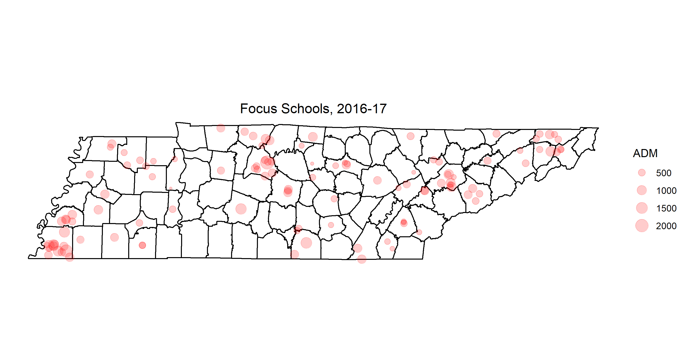
Notes:
20
3
Bedford County
2
40
1
Bledsoe County
3
50
1
Blount County
4
70
2
Campbell County
5
100
1
Carter County
6
110
1
Cheatham County
7
120
1
Chester County
8
140
1
Clay County
9
180
1
Cumberland County
10
190
23
Davidson County
11
220
1
Dickson County
12
260
1
Franklin County
13
280
1
Giles County
14
301
1
Greeneville
15
330
7
Hamilton County
16
350
1
Hardeman County
17
380
2
Haywood County
18
400
1
Henry County
19
460
2
Johnson County
20
470
5
Knox County
21
490
1
Lauderdale County
22
500
1
Lawrence County
23
540
1
McMinn County
24
550
1
McNairy County
25
570
4
Madison County
26
630
3
Montgomery County
27
640
1
Moore County
28
700
1
Polk County
29
710
5
Putnam County
30
740
2
Robertson County
31
750
1
Rutherford County
32
760
1
Scott County
33
792
14
Shelby County
34
800
2
Smith County
35
820
1
Sullivan County
36
821
1
Bristol
37
830
1
Sumner County
38
860
1
Unicoi County
39
870
2
Union County
40
900
1
Washington County
Showing 18 to 40 of 40 entries

Slide 35
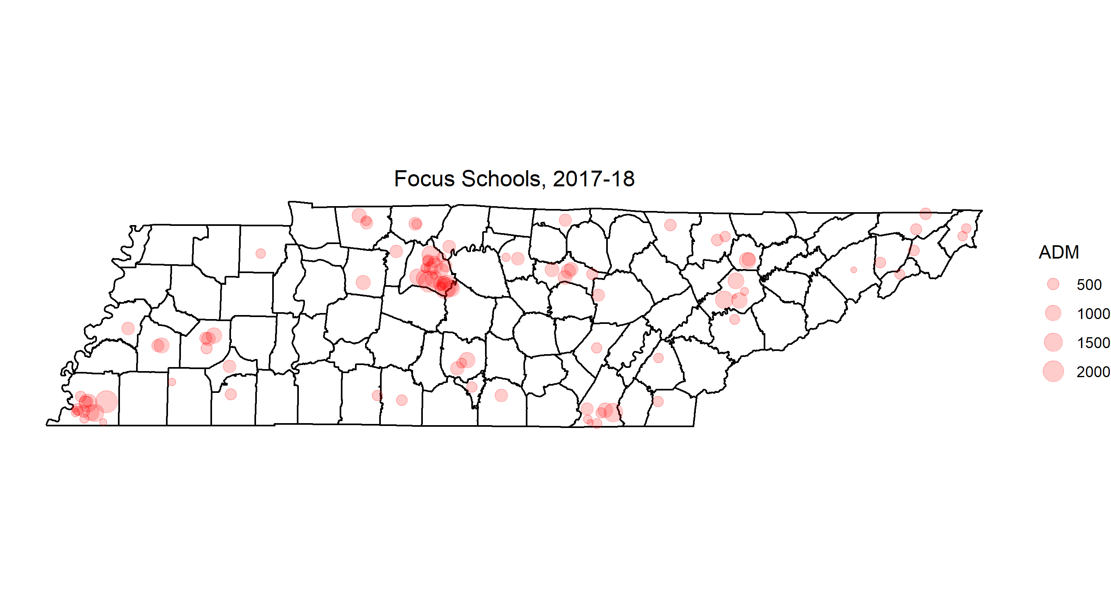
Notes:
20
3
Bedford County
2
40
1
Bledsoe County
3
50
1
Blount County
4
70
2
Campbell County
5
100
1
Carter County
6
110
1
Cheatham County
7
120
1
Chester County
8
140
1
Clay County
9
180
1
Cumberland County
10
190
23
Davidson County
11
220
1
Dickson County
12
260
1
Franklin County
13
280
1
Giles County
14
301
1
Greeneville
15
330
7
Hamilton County
16
350
1
Hardeman County
17
380
2
Haywood County
18
400
1
Henry County
19
460
2
Johnson County
20
470
5
Knox County
21
490
1
Lauderdale County
22
500
1
Lawrence County
23
540
1
McMinn County
24
550
1
McNairy County
25
570
4
Madison County
26
630
3
Montgomery County
27
640
1
Moore County
28
700
1
Polk County
29
710
5
Putnam County
30
740
2
Robertson County
31
750
1
Rutherford County
32
760
1
Scott County
33
792
14
Shelby County
34
800
2
Smith County
35
820
1
Sullivan County
36
821
1
Bristol
37
830
1
Sumner County
38
860
1
Unicoi County
39
870
2
Union County
40
900
1
Washington County
Showing 18 to 40 of 40 entries

